Slide 1

Bank data Analytics via MySQL For diverse customers
Presented by
Mrs. Manasi Sardesai
Data source
Finance_1.xlsx
Finance_2.xlsx
Skills enforced
Basic commands : select,
Group by, order by
distinct, count, sum
join
Team 2
Manasi Sardesai
Nitish Yadav
Syed Zaheen Iqbal
Harshith G V
Sharmishtha Routray
Malta Mohurle
Shreya Tiwari
Tools used

Slide 2
Objective
The aim of this project is to analyze loan data provided by a financial institution for a diverse group of customers. The analysis will focus on customers with varied grades and sub-grade levels, taking into consideration various factors such as loan disbursement reasons, funded amount, revolving balance values, payment modes, and last payment values across different states and geolocations.

Slide 3
Data Points Analyzed:
Year-wise loan amount statistics.
Analysis of revolving balance (revol_bal) based on the loan grades and sub-grades.
Comparison of total payments for customers with Verified Status versus Non-Verified Status.
Examination of loan status based on states and months.
Statistics on Homeownership and its relationship with the last payment date.

Slide 4
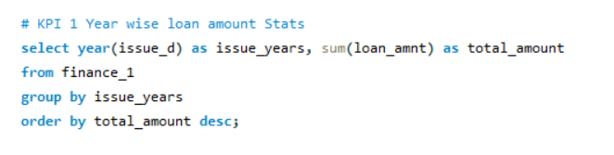
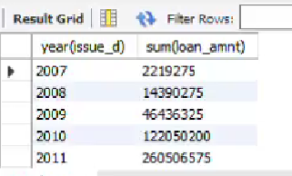
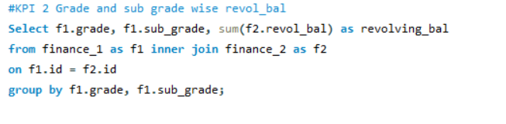
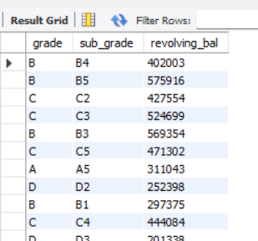

Slide 5
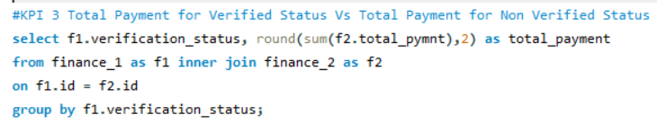
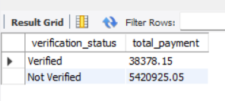
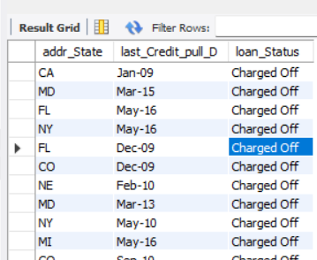
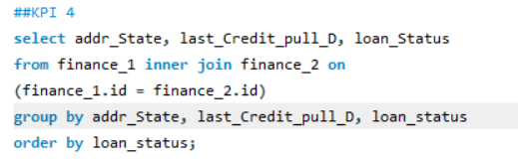
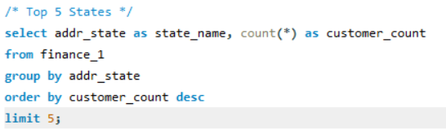
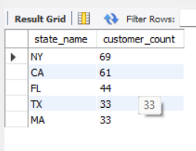

Slide 6
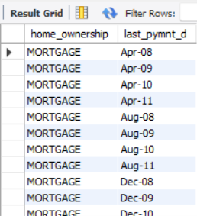
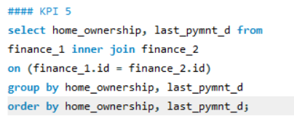
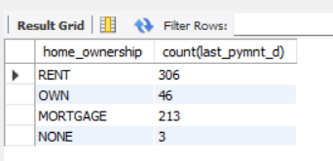
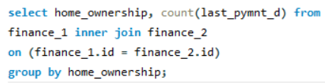

Slide 7
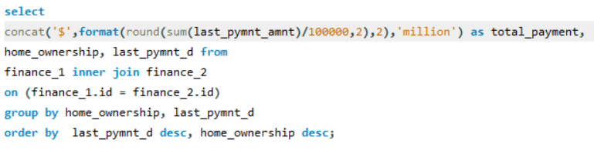
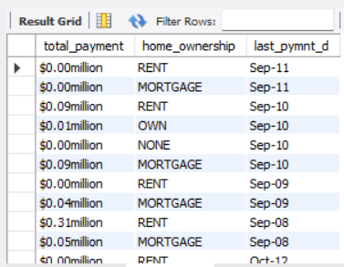

Slide 8
Understanding
How to import csv file and
challenges come for formatting file
How to debug
Deep understanding and
recall of how to write queries

